Slide 1
Planning the Project
A Module in Agile Fundamentals
Notes:
Plan, execute and report on Agile projects
--------------------------------------------------------------------------------------------------------------------
Welcome to the module Planning the Project. This module is brought to you by ThoughtWorks Studios, maker of Mingle, Cruise, and Twist.
In this module, we’ll explore the practices that help Managers and Project Managers plan, execute, and report on Agile projects.

Slide 2

Module Objectives
Learn the purpose and attributes of stories
Understand the relationship of stories, acceptance criteria and testing
Learn about roles and personas and scenarios
Learn how to estimate agile stories
Learn how to plan using estimates, spikes and velocity
Understand the agile lifecycle and planning cadence
Learn about agile metrics and communication
Notes:
Ron Jeffries – ‘Extreme Programming Installed’
Aspects of user stories
[CLICK]
Card – index card or virtual
Repository of information that is the requirements
Placeholder for [CLICK]
Conversation
Not enough info in the card
Has all the parts – Role, Goal, Value
What would the search results look like?
What are the search criteria?
Have the conversation when ready to do the work
Conversations with business, developers, testers
Document enough to do the work
[CLICK]
Confirmation
How we know the story is ‘done’
Acceptance criteria
“I will know this is complete when…..”
Story level acceptance criteria
---------------------------------------------------------------------------------------------------------------------------
You might say that User Stories are the “currency” of Agile Software Development. They are the central elements that identify what we’re doing and why we’re doing it.
Let’s consider the key aspects of User Stories.
First, there’s the Three C’s. [CLICK]
The first C is the Card, or story. Whether you are working in a physical world, and using index cards, or you are working in an electronic world like Mingle, and using virtual cards, this artifact serves two purposes: first, it is the repository of the information that is the story and is about the story; second, it is a placeholder for a future [CLICK]
Conversation. If you examine the story we have here, it is pretty obvious that there is not enough information here to know precisely what to build. It does follow the template, of course – the role is Librarian, the Goal is to have the capability to search books by publication year, and the value is so that a chronological index can be produced. But what would the search results look like? What would I do with them?
In order to clarify these questions, we would wait until we were ready to start development on our story, and then we’d have the Conversation. In the conversation we would dig into the details, figure out enough for the developers and testers to do their work, and document just enough of that information to enable us to do the work.
The third C is Confirmation. This is the combination of Acceptance Criteria and the actual testing to confirm that the goals and value of the story have been satisfied.
Without all three C’s, the story is not effective as a tool to guide the development of the software.

Slide 3

Agile project lifecycle (TW style)
Initiation
(Iteration 0)
Evolve / Handover (…)
Inception
Develop & deploy
Notes:
There is planning – Inception
2 – 4 weeks for a 4 – 6 month project
Flows, scenarios, stories
We need to prepare for Development – Initiation
Environment(s) set up
Narrative writing
Team processes
Develop & Deploy
Release working software
About 12 weeks of work
Common question?? How do I know how big the project is to determine how much time for Inception?
There has been a ‘Conceptualizing’ phase hopefully.
Experience. Relative sizing to other projects you’ve done.

Slide 4
What is Inception?

Slide 5
Collecting Stories
Notes:
Stories are the unit of work that gets measured, tracked, signed off.
Let’s talk about …………
Techniques for writing stories
Techniques for planning with stories
First the template
---------------------------------------------------------------------------------------------------------
While we talked about Stories in an earlier module on The Agile Core, we didn’t talk much about the process and the practices. Since Stories are one of the key tools in an Agile project, we’re going to talk a bit about some of the techniques that will help you in writing stories and working with them as part of the planning process.
Let’s start by reviewing the template for a user story.

Slide 6
User Stories
Three C’s
Card
Conversation
Confirmation
As a Librarian, I want to be able to search for books by publication year so that I can produce a chronological index
Notes:
Ron Jeffries – ‘Extreme Programming Installed’
Aspects of user stories
[CLICK]
Card – index card or virtual
Repository of information that is the requirements
Placeholder for [CLICK]
Conversation
Not enough info in the card
Has all the parts – Role, Goal, Value
What would the search results look like?
What are the search criteria?
Have the conversation when ready to do the work
Conversations with business, developers, testers
Document enough to do the work
[CLICK]
Confirmation
How we know the story is ‘done’
Acceptance criteria
“I will know this is complete when…..”
Story level acceptance criteria
---------------------------------------------------------------------------------------------------------------------------
You might say that User Stories are the “currency” of Agile Software Development. They are the central elements that identify what we’re doing and why we’re doing it.
Let’s consider the key aspects of User Stories.
First, there’s the Three C’s. [CLICK]
The first C is the Card, or story. Whether you are working in a physical world, and using index cards, or you are working in an electronic world like Mingle, and using virtual cards, this artifact serves two purposes: first, it is the repository of the information that is the story and is about the story; second, it is a placeholder for a future [CLICK]
Conversation. If you examine the story we have here, it is pretty obvious that there is not enough information here to know precisely what to build. It does follow the template, of course – the role is Librarian, the Goal is to have the capability to search books by publication year, and the value is so that a chronological index can be produced. But what would the search results look like? What would I do with them?
In order to clarify these questions, we would wait until we were ready to start development on our story, and then we’d have the Conversation. In the conversation we would dig into the details, figure out enough for the developers and testers to do their work, and document just enough of that information to enable us to do the work.
The third C is Confirmation. This is the combination of Acceptance Criteria and the actual testing to confirm that the goals and value of the story have been satisfied.
Without all three C’s, the story is not effective as a tool to guide the development of the software.

Slide 7
User Stories
Three C’s
INVEST
Card
I
Independent
N
Negotiable
Conversation
V
Valuable
E
Confirmation
Estimatable
S
Small
T
Testable
As a Librarian, I want to be able to search for books by publication year so that I can produce a chronological index
Notes:
Guidelines for writing good stories
Independent
Sales amount, sales percent, discount amount, discount percent
May want to split it – too big to fit into an iteration
Reports example. Or business rule applied to different products.
Write each as if they were the first story
Negotiable
Not a contract of what the software must implement
Conversations bring out details
Negotiate implementation, design
Get external links example.
Valuable
Valuable to the business, user, customer
This is the ‘So that’ part of the template
Everyone on the team should be able to articulate the value of the story
Estimatable
Clear and complete enough for the developers to estimate
If split as above, estimate the whole work for each.
Once foundation is complete, re-estimate the later stories
Small
Mike Cohn said it well:
“Like Goldilocks in search of a comfortable bed, some stories can be too big, some can be too small, and some can be just right. Story size does matter because if stories are too large or too small you cannot use them in planning.”
Must be completed in an Iteration.
Testable
Mike Cohn again:
“Stories must be written so as to be testable. Successfully passing its tests proves that a story has been successfully developed. If the story cannot be tested, how can the developers know when they have finished coding?”
----------------------------------------------------------------------------------------------------------
Next we have one of the key acronyms that helps us write and judge effective user stories: INVEST. This is one that you’ll want to learn, because you’ll find yourself using it all the time.
[CLICK] The I stands for Independent. As a valuable goal, we strive to ensure that each of our user stories is independent. That means that we try to write them in such a fashion that they can be estimated and implemented independently of other user stories. We’ll get into this in more detail later, because it’s such an important point. For now, let me give you an example: when working on a business intelligence project, a team wrote a story that included four measures in its Goal: sales amount, sales percent, discount amount, discount percent. At the first writing, this seemed to be a reasonable story. After a bit of understanding and experience was gained, it became clear that it made sense to break this into four stories. Of course, the development team’s first reaction was that they had to pick one story to do first, so that they could do all the underlying work with that story. That would mean that the other stories would be dependent on that story getting done first. This is a mistake that many teams make when working with stories. When we get further down in the INVEST acronym, we’ll talk more about why this is so.
[CLICK] The N stands for Negotiable. This means that stories are not written contracts or requirements that the software must implement. Story cards are short descriptions of functionality, the details of which are to be negotiated in a conversation between the customer and the development team. Because story cards are reminders to have a conversation rather than fully detailed requirements themselves, they do not need to include all relevant details. This allows room in the discussion, at the time the story is implemented, to negotiate some of the details and the implementation.
[CLICK] The V stands for Valuable. This means that it is valuable to purchasers or users of the software, and also means that it is valuable to the business. As we discussed earlier, when reviewing the story template, being able to articulate the value of a story is essential. Without being able to articulate and understand the value, it is reasonable to question why we’re writing or implementing a story.
[CLICK] The E stands for Estimatable. That means that a story must be at a fine enough granularity, with enough clarity and detail, that the team is able to estimate it. Let’s go back to the story we introduced when talking about the “I” for Independent. When this story first came up – the story including the four measures – the team estimated it relatively high, because of the combination of foundational work – adding to and modifying the database, for instance – and the detail required for each of the measures. Upon reflection, as noted earlier, the team opted to separate this story into four separate stories, one for each measure. The problem was with that Independence. They said “if we implement any one of these stories first, it will be an eight – any other story will be a two after that – so which story should we do first?” The answer was to estimate them all independently, as if they were going to do all of that foundational work on all of them. Of course, we know that that would not be the case, but it enables the team to maintain that independence. When it came time to choose among the stories for implementation, that left the Product Owner with the freedom to choose any of them, based on current priorities. Once the first story was done, the team could then re-estimate the remaining stories with the understanding that the foundational work had been done and the remaining stories would be easier to implement.
[CLICK] The S stands for Small. Mike Cohn said it well: “Like Goldilocks in search of a comfortable bed, some stories can be too big, some can be too small, and some can be just right. Story size does matter because if stories are too large or too small you cannot use them in planning.” Further, Mike says “The ultimate determination of whether a story is appropriately sized is based on the team, its capabilities, and the technologies in use.” When we work with Agile teams, one of the guidelines we use is whether a story can be completed in an Iteration.
[CLICK] And finally, the T stands for Testable. Let’s quote Mike Cohn again: “Stories must be written so as to be testable. Successfully passing its tests proves that a story has been successfully developed. If the story cannot be tested, how can the developers know when they have finished coding?”
Remember the acronym – INVEST – Independent, Negotiable, Valuable, Estimatable, Small, and Testable.

Slide 8
Parts of a Story
Unique #:
Title:
Description:
As a
I want to
So that
Assumptions:
Estimate:

Slide 9
Parts of a Story
I will know this is complete when…….

Slide 10
User Story Template
Role: As a …
Goal: I want/need …
Value: So that …
From User Stories Applied: For Agile Software Development by Mike Cohn
Notes:
From Mike Cohn’s book “User Stories Applied”.
Role
Identified during inception
Identifier for a common set of tasks or permissions
[CLICK]
Goal
What the user wants to do, not what the system is supposed to do.
The feature
[CLICK]
Value
Why are we building this functionality?
Should tie back to a business objective
--------------------------------------------------------------------------------------------------------------------
The story template we use comes from Mike Cohn’s book “User Stories Applied”. It has three parts:
The Role: this is an identifier for a common set of tasks or permissions.
The Goal: this is what is to be accomplished. This is stated in terms of what the person or role wants to accomplish, not what the system is supposed to do.
The Value: this is one of the most important parts. Without understanding what this story means to the person in the role or the organization – the business – we are left asking the question “why are we doing this?” The value statement may be the hardest part of user stories. Expressing the role and the goal are generally pretty clear, although we’ve seen some challenges there too. The value, though, is hard. People are inclined to say things like “because that’s my job!” or “so that we can do our business.”
We’ll come back to this template repeatedly as we go, because it’s such a key part of what we do and how we do it.

Slide 11
Acceptance Criteria
I’ll know this is complete when…….
Notes:
Inception level vs. Iteration level criteria
Inception - I’ll know this is complete when …… [CLICK]
Iteration Level…
Given – preconditions to the story. State of the system, object, role [CLICK]
When – the action[CLICK]
Then – the result
Gives context for estimating
Security is a good example.
I’ll know this is complete when each role logs in and they receive the proper access or not.
vs. each role spelled out in the Narrative as a separate Given, when then statement.
When each statement is fulfilled, the story is done
-------------------------------------------------------------------------------------------------------------------------------
Now that we have a story, we need to address that Testable attribute. We do this by defining the acceptance criteria. That is, we identify those criteria which, when met, allow us to assert that the story has been completely and successfully implemented.
While there are many ways to phrase or write the acceptance criteria, we prefer the scenario template devised by Dan North and Chris Matts, and first documented in an article by Dan published in Better Software magazine in March of 2006. You can read it on Dan’s blog at dannorth.net/introducing-bdd as you’ll see on the slide.
The template has three clauses, like the user story template. In this case, they specify…
[CLICK] the initial context, using the keyword “given”. This clause identifies the pre-existing conditions that must exist before we can execute or experience…
[CLICK] the event, or action, which is specified using the “when” keyword. Finally, we specify…
[CLICK] the outcomes or expectations using the “then” keyword. Here’s an example…
[CLICK] First, the context – the user must not be logged in. Note that the Given – the context – is NOT part of the test, but rather is the set-up. That is, in this case we assume that the ability to log in and the permissions associated with that logging in have been dealt with elsewhere. This particular scenario is focused on verifying that a user is required to log in before being able to click on the Shopping Cart link. It is not focusing on whether or not it is possible to log in.
Once the context is set up, then we have the specific event, or behaviour, that is executed. This is the action in the test. In this case, the action is to click on the Shopping Cart link.
Finally, the scenario specifies one or more outcomes. In this case, the user should be required to log in. This might more properly be written “a login form is presented to the user” since that is measurable.
It’s important to note that there may be multiple parts to the Context – the Given clause – and to the Outcomes – the Then clause – but there will normally be only a single part to the Event – the When clause.
The acceptance criteria should be written so that they are executable, preferably in code.
We’ll talk about when to add the acceptance criteria to a story later in this module.

Slide 12


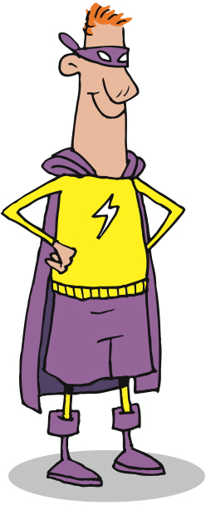

Roles
Notes:
So how do we get these stories?
Through a number of analysis sessions.
Roles, the first part of our story template.
Roles define a set of actions and permissions
Initially identified during inception. Can be added, eliminated.
One person may fulfill multiple roles
Consider Fred [CLICK]
Fred is in the sales department. [CLICK]
Salesman [CLICK]
Super user for the sales automation team [CLICK]
Clerical or administrative work for the Customer Service group
By discussing what these roles will likely do with the system, we get stories
----------------------------------------------------------------------------------------------------------
In talking about our template for user stories, the first clause is the Role clause.
Roles, not to be confused with Personas, identify the ways in which the system will be used. Those ways reflect a particular type of user or member of an organization. There is nothing personal about a Role, and Roles need not be mutually exclusive. Further, a single individual (real or Persona) may act in or fill multiple roles, and may take on different Roles at different times.
It is essential to identify the core set of Roles that are the subjects of stories.
Additional Roles may be identified over time, and Roles may be combined or eliminated.
So let’s consider our friend Fred here [CLICK]. Fred is in the Sales department. Sometimes, [CLICK] Fred is a salesman, doing what salesmen do.
Sometimes, [CLICK] because of his technical expertise, Fred is the superuser for the sales automation system.
And sometimes, [CLICK] Fred does clerical and administrative work, like after a big trade show when he enters information about all the people that came to his company’s booth.
As you can see, roles are about activities and permissions, and not about people.

Slide 13
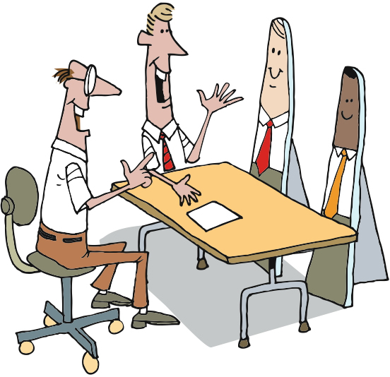
Personas
Notes:
Created individuals given names – Bill, Jack
Have characteristics like – biographic, technographic, attitudes, relationship to/from the business, etc
Used to create paths through the system
“How would Bill search for a flight?”
Bill and Jack may have the same role, but different Personas
By discussing the different personas and how they’d interact with the system we get stories.
---------------------------------------------------------------------------------------------------------------------
Now let’s talk about Personas.
Personas are created people. They combine sets of characteristics that allow the project team to talk about them as if they were real. The advantages over using real people are that there’s no danger of offending someone when we talk about them, there’s no need to ask someone personal questions, the personas are crafted to satisfy a need, and they don’t have to get fed or paid. [hopefully, this will get a chuckle – pause for the chuckle]
Personas take on Roles, just like real people. However, unlike Roles, they are not incorporated into Stories. Rather they are used as the context and checkpoint for Stories. That is, if there are Personas named Sharon and Fred, we might ask “How would Fred do that?” or “Would that satisfy Sharon?”
The more we talk about them, the more real they become. We work hard to avoid saying “What would a Superuser do?” when talking about acceptance criteria and system flow, and try to stay with the Personas. That helps us remember that more than one Persona may take on the same Role, and that each Persona can take on multiple Roles.

Slide 14

Personas
Jane, the QA Manager
37 Years Old
Married
No children
Two dachshunds, both female
Worked her way up from tester
BS in MIS
Hobbies: bicycling, musical theater
Subscribes to Quality Software Magazine
Photo from JesperM on Flickr @ http://www.flickr.com/photos/51344793@N00/353164703/
Notes:
To create a persona we discuss
Background and history
Professional experience
Technological level
Hobbies
Goals
Relationship to the business
Find a photograph that gives the persona visibility
Hung up in the team room
----------------------------------------------------------------------------------------------
To create personas, we talk about their background and history, their professional experience, their families, their education, their hobbies, and more. We try to make them as real as possible.
Typically, we will find a photograph – usually from a clipart site, so it’s not someone we know – to use for the persona. We’ll create persona sheets – profiles with the picture – and put them where they’re visible to all of the members of the team.
Once we’ve identified a persona, and as we begin to flesh them out, we’ll start to develop scenarios.

Slide 15
Why Roles AND Personas?
Role
Persona
Characteristics & Behaviors
Activities & Permissions
Drives story value
Drives scenarios
Is impersonal
Is personal and “real”
May be individual or collective
Is individual
Notes:
Add some content about how we use each - personas in both forward and backward looking, BA/UX, Dev,...

Slide 16
Use Cases to Scenarios
1 Use Case
Many scenarios…
Start of use case
Step 1
Alt 1
Step 2
Step 3
Alt 3
Step 4
Step 5
Step 6
Alt 2
Step 7
End of use case
Notes:
Another source of stories are use cases.
Use cases can be broken down into scenarios.
The scenarios can then be dissected for stories.

Slide 17
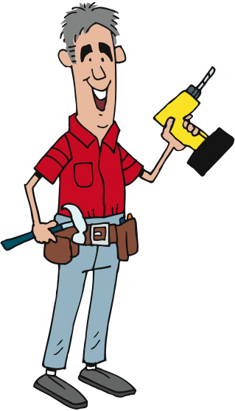
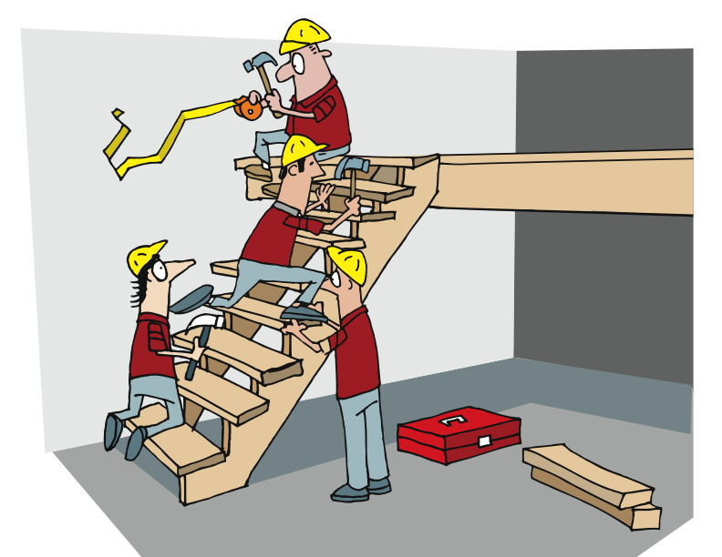
Scenarios
Scenario
=
a persona
+
a task
+
an environment
Notes:
A story about how a persona might accomplish a task
Book a flight
The super user may jump directly to a particular airline
The casual user may want to browse all airlines
Some current processes, some visionary or new
-------------------------------------------------------------------------------------------------------------
We use Scenarios to drive out requirements and to validate that solutions can solve the tasks identified in all possible environments. This is where we might see various personas taking on multiple roles and helping us to understand how they would use, and respond to, the solution we’re developing. In fact, Scenarios tie pretty directly to the way in which we state our acceptance criteria.
Some of the scenarios we create will be current – how things work today – and some will be visionary – how things will be sometime in the future. All of them will help us to understand how the system we’re building will effectively serve our customers.

Slide 18
Low-Fi Prototyping
“a prototype that is sketchy and incomplete, that has some characteristics of the target product but is otherwise simple, usually in order to quickly produce the prototype and test broad concepts.”
From http://www.usabilityfirst.com/glossary/term_378.txl:
Notes:
I’ll let you read this before we begin.
[PAUSE LONG ENOUGH TO READ THIS AT LEAST ONCE]
Allows you to run scenarios through the system without coding anything
Low cost
Paper
Another name for low-fidelity prototyping is "paper prototyping" and perhaps this name more fittingly describes what you use in the process. The purpose of the low-fidelity prototype is to allow you to design the interface of your application before you focus on anything else.

Slide 19
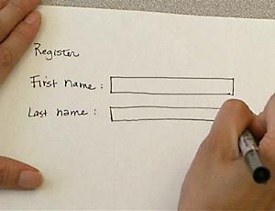
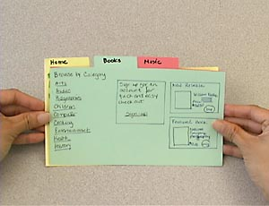
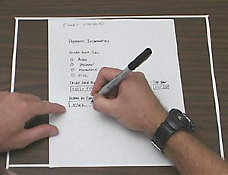
Low-Fi Prototyping
Notes:
Allows teams to test out interfaces without writing code.
Easy and inexpensive modifications
User is involved and comfortable being critical of a paper document vs a coded look
By running the various scenarios through the prototypes, you can find new requirements
Mid fi – Balsamiq
-------------------------------------------------------------------------------------
From an article in Wikipedia, we get:
Paper prototyping saves time and money since it enables developers to test product interfaces (from software and websites to cell phones and microwave ovens) before they write code or begin development. This also allows for easy and inexpensive modification to existing designs which makes this method useful in the early phases of design. Using paper prototyping allows the entire creative team to be involved in the process, which eliminates the chance of someone with key information not be involved in the design process. Another benefit of paper prototyping is that users feel more comfortable being critical of the mock up because it doesn’t have a polished look.
There are different methods of paper prototyping, each of them showing several benefits regarding the communication within the development team and the quality of the product to be developed: In the development team paper prototypes can serve as a visual specification of the graphical user interface, and by this means assure the quality of a software. Prototyping forces a more complete design of the user interface to be captured. In team meetings they provide a communication base between the team members. Testing prototypes at an early stage in development helps to identify software usability problems even before any code is written. The costs and annoyances of later changes are reduced, the support burden is lowered, and the overall quality of the software or website is increased.

Slide 20
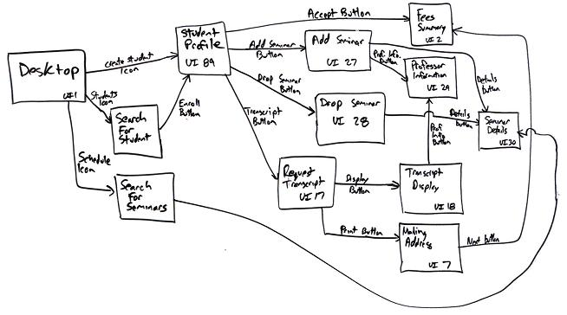
Storyboarding
Notes:
Intersects with Prototyping, Roles, Personas
Maps the interface flow of stories through the system.
Models the user interactions with the product.
High level overview of the product
-----------------------------------------------------------------------------
Storyboarding is another technique, and it intersects with Low-Fi Prototypes, Roles, and Personas.
Storyboards identify a flow of activities in the software/system, with each “frame” of the story representing a step in the process. Storyboards are similar in some ways to Flow Charts, except that they are more textual and contextual.
User interface-flow diagrams are typically used for one of two purposes. First, they are used to model the interactions that users have with your software, as defined in a single use case. For example, a use case can refer to several screens and provides insight into how they are used. Based on this information, you can develop a user interface-flow diagram that reflects the behavioral view of the single use case. Second, they enable you to gain a high-level overview of the user interface for your application. This overview is effectively the combination of all the behavioral views derived from your use cases, the result being called the architectural view of your user interface

Slide 21
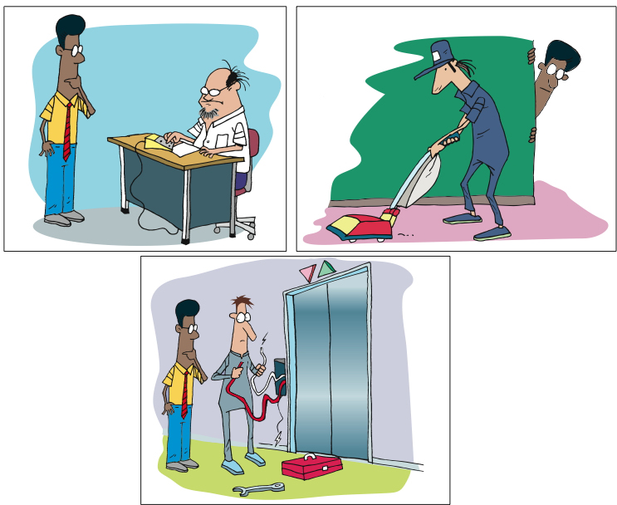
Contextual Design & Contextual Inquiry
Notes:
A component of Contextual Design
Observing someone do their job and then applying the understanding to the design.
Reduces misunderstandings of a process and missed steps that users forget to describe.
Get information A, get information B, etc is different if that information comes from one system vs different places
----------------------------------------------------------------------------------
One of the ways in which we gather information is through Contextual Inquiry.
Contextual Inquiry is a component of a design approach called Contextual Design, developed by Beyer & Holtzblatt.
The approach focuses on observing users as they do their jobs, and then [CLICK] applying that contextual understanding to design.
Context is important to understanding. Without context, we are subject to misunderstanding, and to building the wrong thing.
Gaining an understanding of how and why and where and when our prospective users and customers do what they do will enable us to more effectively meet their needs.

Slide 22
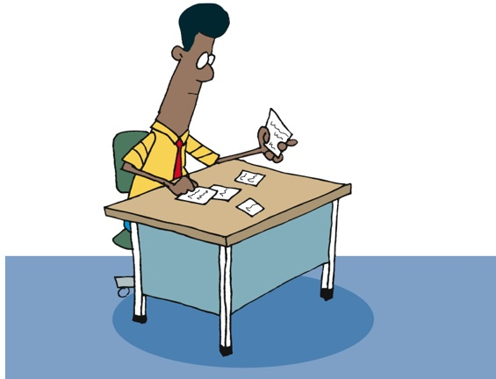
Contextual Design & Contextual Inquiry
Use learning to inform story writing and acceptance criteria
Notes:
A component of Contextual Design
Observing someone do their job and then applying the understanding to the design.
Reduces misunderstandings of a process and missed steps that users forget to describe.
Get information A, get information B, etc. is different if that information comes from one system vs. different places
----------------------------------------------------------------------------------
One of the ways in which we gather information is through Contextual Inquiry.
Contextual Inquiry is a component of a design approach called Contextual Design, developed by Beyer & Holtzblatt.
The approach focuses on observing users as they do their jobs, and then [CLICK] applying that contextual understanding to design.
Context is important to understanding. Without context, we are subject to misunderstanding, and to building the wrong thing.
Gaining an understanding of how and why and where and when our prospective users and customers do what they do will enable us to more effectively meet their needs.

Slide 23
In Summary
Template of a Story
3 Cs
INVEST
Acceptance Criteria
Roles
Personas
Scenarios
Prototyping
Story Boarding
Contextual Analysis

Slide 24
Estimating Stories
Notes:
We’ve got stories built from our flows, prototypes, personas, scenarios
Now we need to estimate them
Now that we’ve talked about stories and roles and personas and low-fi prototyping and storyboarding – that is, the tools and artifacts that enable us to know what we’ll be building - let’s talk about how we do our planning and communicating.

Slide 25
Estimating the Effort
Notes:
Accuracy – degree of closeness
Precision – reproducibility or repeatability
Results of calculations or measurements can be:
Accurate but not precise
Precise but not accurate
----------------------------------------------------------------------------------------------------------
Agile estimation is one of the parts that folks new to Agile struggle with. In this section, we’ll dig into the why and the how, and then give you some very specific practices.
Let’s begin with gaining an understanding of the terms “accuracy” and “precision”.
From Wikipedia, we get this definition: [CLICK]
In the fields of science, engineering, industry and statistics, accuracy is the degree of closeness of a measured or calculated quantity to its actual (true) value.
Accuracy is closely related to precision, also called reproducibility or repeatability, the degree to which further measurements or calculations show the same or similar results.
The results of calculations or a measurement can be accurate but not precise, precise but not accurate, neither, or both. A measurement system or computational method is called valid if it is both accurate and precise. The related terms are bias (non-random or directed effects caused by a factor or factors unrelated by the independent variable) and error (random variability), respectively.

Slide 26
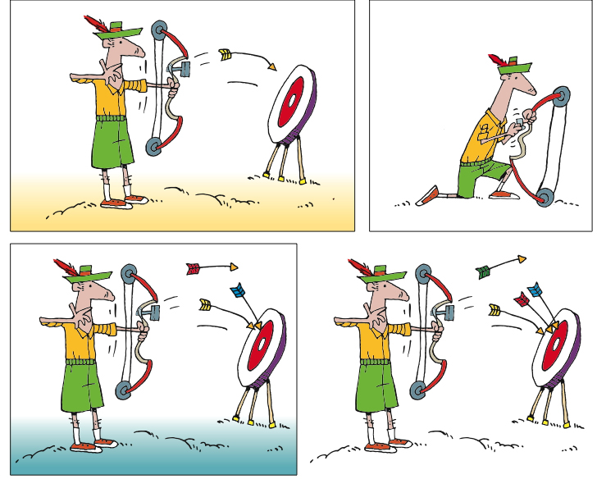
Accuracy and Precision
Notes:
Goals around both Accuracy and Precision in Agile estimation
There is accountability
Accuracy is hard
Who will do the work – different skill sets, capabilities [CLICK]
Precision requires consistent accuracy, therefore maybe adjusting assumptions, etc
----------------------------------------------------------------------------------------------
Based on the definitions of accuracy and precision, we have goals around both in Agile estimation. However, the challenge we face is to understand the value of each.
Accuracy is important when we are estimating in a time-based system. Whether person-hours/days or ideal hours/days, accuracy is measurable. When it is measurable, there is accountability. Being accurate is hard, especially when the team includes people of different capability, speed, and consistency, and it is not known who will perform the work when the estimate is made.
[CLICK] Precision is important when we are estimating as a group, and over time. Precision generally refers to how consistent we are in our estimation, both across the members of the team, and across time. The ideal test would be to estimate a story today, and estimate it again a week or a month or a year from now, and to see whether we come up with the same estimate.

Slide 27
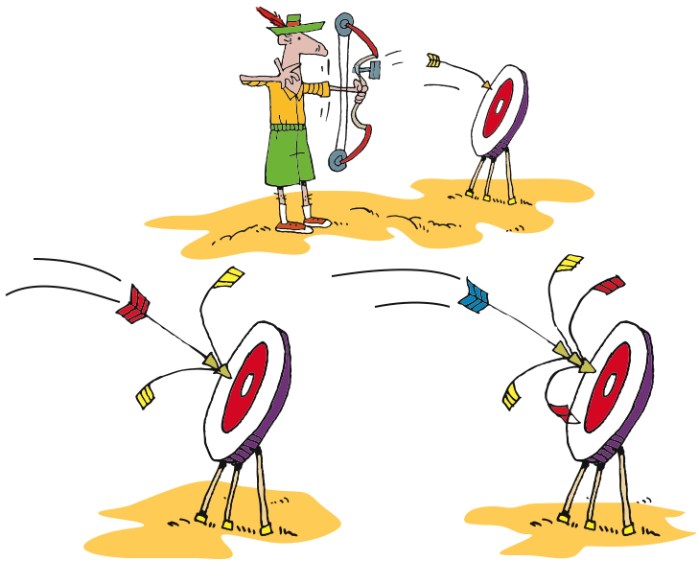
Accuracy and Precision
Notes:
Goals around both Accuracy and Precision in Agile estimation
There is accountability
Accuracy is hard
Who will do the work – different skill sets, capabilities [CLICK]
Precision requires consistent accuracy, therefore maybe adjusting assumptions, etc
----------------------------------------------------------------------------------------------
Based on the definitions of accuracy and precision, we have goals around both in Agile estimation. However, the challenge we face is to understand the value of each.
Accuracy is important when we are estimating in a time-based system. Whether person-hours/days or ideal hours/days, accuracy is measurable. When it is measurable, there is accountability. Being accurate is hard, especially when the team includes people of different capability, speed, and consistency, and it is not known who will perform the work when the estimate is made.
[CLICK] Precision is important when we are estimating as a group, and over time. Precision generally refers to how consistent we are in our estimation, both across the members of the team, and across time. The ideal test would be to estimate a story today, and estimate it again a week or a month or a year from now, and to see whether we come up with the same estimate.

Slide 28
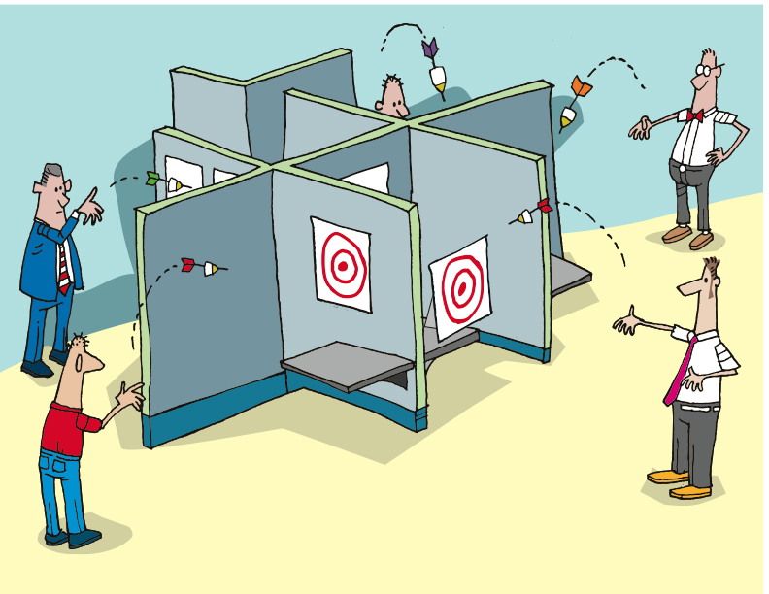
Notes:
Estimating in isolation leads to inaccurate estimates.
No discussion, questions, clarifications
---------------------------------------------------------------------------------------------------------
In Waterfall, it is common for individuals to perform estimation in isolation. They review each item and answer the question “Assuming I am the one who will do this work, how long do I think it will take?” They take their best guess, then [CLICK] submit their estimates, generally without collaboration or conversation with other members of their team.
Of course, they don’t yet know what they don’t know. And they don’t know what they will know when it comes time to do the work. And they don’t know that it will actually be them doing the work. As a result, the combined estimates are generally highly inaccurate and imprecise, leading to flawed project plans.

Slide 29
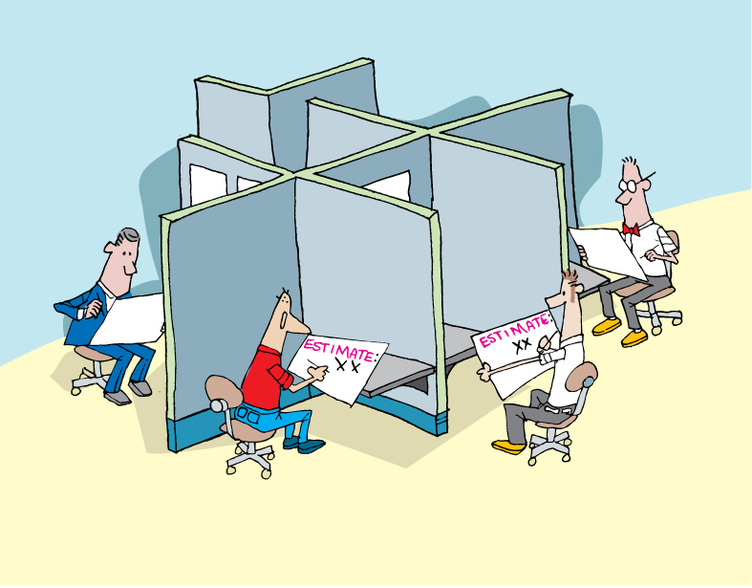
Notes:
Estimating in isolation leads to inaccurate estimates.
No discussion, questions, clarifications
---------------------------------------------------------------------------------------------------------
In Waterfall, it is common for individuals to perform estimation in isolation. They review each item and answer the question “Assuming I am the one who will do this work, how long do I think it will take?” They take their best guess, then [CLICK] submit their estimates, generally without collaboration or conversation with other members of their team.
Of course, they don’t yet know what they don’t know. And they don’t know what they will know when it comes time to do the work. And they don’t know that it will actually be them doing the work. As a result, the combined estimates are generally highly inaccurate and imprecise, leading to flawed project plans.

Slide 30
Units of Measure
Story points
Ideal days
Card count

Slide 31
Agile Estimation: Planning Poker
0 + 1 = 1
1 + 1 = 2
1 + 2 = 3
2 + 3 = 5
3 + 5 = 8
5 + 8 = 13
8 + 13 = 21
Notes:
Various systems of estimates used
We use the Fibonacci Sequence
Documented by Leonardo Pisano Bogollo aka Leonardo Fibonacci
Perhaps the most talented mathematician of the middle ages
Each number is the sum of the previous 2 [CLICK]
Teams usually define what system they will use. 1,2,3,5, 8
------------------------------------------------------------------------------------------------------------------
There are various systems of estimation used, when applying Planning Poker. We use the Fibonacci Sequence numbers. The Fibonacci Sequence was documented by Leonardo Pisano Bogollo, also known as Leonardo Fibonacci, who was considered to be perhaps the most talented mathematician of the Middle Ages.
In the Fibonacci sequence, each number is the sum of the previous two numbers, starting with 0 and 1. Thus the sequence begins 0, 1, 1, 2, 3, 5, 8, 13, 21, 34
For Planning Poker, we use 0, 1, 2, 3, 5, 8, and 13. Some include 20 and 40 and 100 in our planning poker decks, in order to indicate that a story is too large to be done in a single iteration.

Slide 32
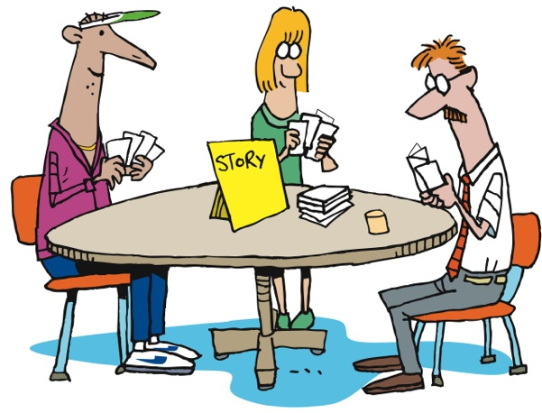
Agile Estimation: Planning Poker
Notes:
How does it work?
First the BA presents the story to the team.
Then everyone thinks about the estimate [CLICK]
Then everyone throws their estimate at the same time
No one is influenced by anyone else [CLICK]
There may be outliers [CLICK]
There is discussion about the outliers [CLICK]
Everyone re-thinks [CLICK]
Then re-throw
Sometimes necessary, sometimes not
----------------------------------------------------------------------------------------------------------------
Let’s look at how it’s done…
First, we gain a clear understanding of the story, including the acceptance criteria and the tasks needed to complete the story. Once all members of the team feel that they have that understanding, each member of the team selects the number that they feel represents the relative complexity of the story, as compared to other stories that the team has implemented.
As a group, [CLICK] team members reveal their estimates – the numbers they have chosen, that is. Revealing all at once prevents any team member from being influenced by another team member’s estimate.
It’s not unusual for there to be outliers [CLICK] – estimates that are different from the majority. When this happens, [CLICK] the team discusses the differences. Some will have thought of other tasks, or understood the tasks differently. Sometimes it’s QA who sees things differently. [CLICK]
Regardless, after discussing things, the team [CLICK] estimates again. If it takes more than three rounds of estimating, there’s a smell that needs to be addressed. The story may need to be rewritten or more analysis may need to be done.
Of course, sometimes the people who have thrown the outliers will agree to change their estimates without another round of estimating, once they understand the thinking of their teammates. In this case, no additional rounds of Planning Poker are needed for that story.

Slide 33
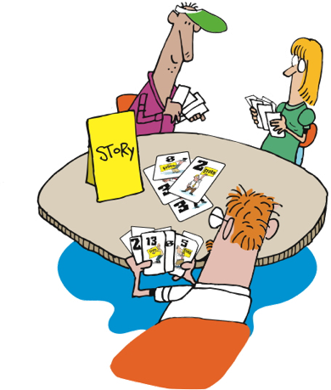
Agile Estimation: Planning Poker
Notes:
How does it work?
First the BA presents the story to the team.
Then everyone thinks about the estimate [CLICK]
Then everyone throws their estimate at the same time
No one is influenced by anyone else [CLICK]
There may be outliers [CLICK]
There is discussion about the outliers [CLICK]
Everyone re-thinks [CLICK]
Then re-throw
Sometimes necessary, sometimes not
----------------------------------------------------------------------------------------------------------------
Let’s look at how it’s done…
First, we gain a clear understanding of the story, including the acceptance criteria and the tasks needed to complete the story. Once all members of the team feel that they have that understanding, each member of the team selects the number that they feel represents the relative complexity of the story, as compared to other stories that the team has implemented.
As a group, [CLICK] team members reveal their estimates – the numbers they have chosen, that is. Revealing all at once prevents any team member from being influenced by another team member’s estimate.
It’s not unusual for there to be outliers [CLICK] – estimates that are different from the majority. When this happens, [CLICK] the team discusses the differences. Some will have thought of other tasks, or understood the tasks differently. Sometimes it’s QA who sees things differently. [CLICK]
Regardless, after discussing things, the team [CLICK] estimates again. If it takes more than three rounds of estimating, there’s a smell that needs to be addressed. The story may need to be rewritten or more analysis may need to be done.
Of course, sometimes the people who have thrown the outliers will agree to change their estimates without another round of estimating, once they understand the thinking of their teammates. In this case, no additional rounds of Planning Poker are needed for that story.

Slide 34
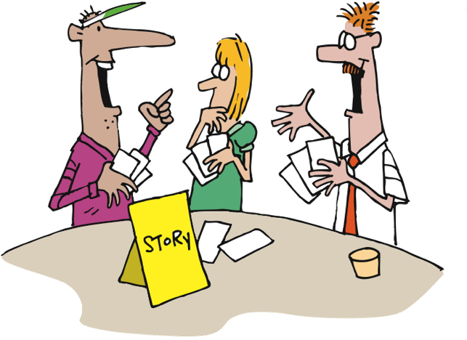
Agile Estimation: Planning Poker
Notes:
How does it work?
First the BA presents the story to the team.
Then everyone thinks about the estimate [CLICK]
Then everyone throws their estimate at the same time
No one is influenced by anyone else [CLICK]
There may be outliers [CLICK]
There is discussion about the outliers [CLICK]
Everyone re-thinks [CLICK]
Then re-throw
Sometimes necessary, sometimes not
----------------------------------------------------------------------------------------------------------------
Let’s look at how it’s done…
First, we gain a clear understanding of the story, including the acceptance criteria and the tasks needed to complete the story. Once all members of the team feel that they have that understanding, each member of the team selects the number that they feel represents the relative complexity of the story, as compared to other stories that the team has implemented.
As a group, [CLICK] team members reveal their estimates – the numbers they have chosen, that is. Revealing all at once prevents any team member from being influenced by another team member’s estimate.
It’s not unusual for there to be outliers [CLICK] – estimates that are different from the majority. When this happens, [CLICK] the team discusses the differences. Some will have thought of other tasks, or understood the tasks differently. Sometimes it’s QA who sees things differently. [CLICK]
Regardless, after discussing things, the team [CLICK] estimates again. If it takes more than three rounds of estimating, there’s a smell that needs to be addressed. The story may need to be rewritten or more analysis may need to be done.
Of course, sometimes the people who have thrown the outliers will agree to change their estimates without another round of estimating, once they understand the thinking of their teammates. In this case, no additional rounds of Planning Poker are needed for that story.

Slide 35

Agile Estimation: Planning Poker
Notes:
How does it work?
First the BA presents the story to the team.
Then everyone thinks about the estimate [CLICK]
Then everyone throws their estimate at the same time
No one is influenced by anyone else [CLICK]
There may be outliers [CLICK]
There is discussion about the outliers [CLICK]
Everyone re-thinks [CLICK]
Then re-throw
Sometimes necessary, sometimes not
----------------------------------------------------------------------------------------------------------------
Let’s look at how it’s done…
First, we gain a clear understanding of the story, including the acceptance criteria and the tasks needed to complete the story. Once all members of the team feel that they have that understanding, each member of the team selects the number that they feel represents the relative complexity of the story, as compared to other stories that the team has implemented.
As a group, [CLICK] team members reveal their estimates – the numbers they have chosen, that is. Revealing all at once prevents any team member from being influenced by another team member’s estimate.
It’s not unusual for there to be outliers [CLICK] – estimates that are different from the majority. When this happens, [CLICK] the team discusses the differences. Some will have thought of other tasks, or understood the tasks differently. Sometimes it’s QA who sees things differently. [CLICK]
Regardless, after discussing things, the team [CLICK] estimates again. If it takes more than three rounds of estimating, there’s a smell that needs to be addressed. The story may need to be rewritten or more analysis may need to be done.
Of course, sometimes the people who have thrown the outliers will agree to change their estimates without another round of estimating, once they understand the thinking of their teammates. In this case, no additional rounds of Planning Poker are needed for that story.

Slide 36
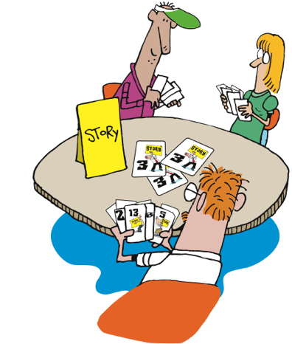
Agile Estimation: Planning Poker
Notes:
How does it work?
First the BA presents the story to the team.
Then everyone thinks about the estimate [CLICK]
Then everyone throws their estimate at the same time
No one is influenced by anyone else [CLICK]
There may be outliers [CLICK]
There is discussion about the outliers [CLICK]
Everyone re-thinks [CLICK]
Then re-throw
Sometimes necessary, sometimes not
----------------------------------------------------------------------------------------------------------------
Let’s look at how it’s done…
First, we gain a clear understanding of the story, including the acceptance criteria and the tasks needed to complete the story. Once all members of the team feel that they have that understanding, each member of the team selects the number that they feel represents the relative complexity of the story, as compared to other stories that the team has implemented.
As a group, [CLICK] team members reveal their estimates – the numbers they have chosen, that is. Revealing all at once prevents any team member from being influenced by another team member’s estimate.
It’s not unusual for there to be outliers [CLICK] – estimates that are different from the majority. When this happens, [CLICK] the team discusses the differences. Some will have thought of other tasks, or understood the tasks differently. Sometimes it’s QA who sees things differently. [CLICK]
Regardless, after discussing things, the team [CLICK] estimates again. If it takes more than three rounds of estimating, there’s a smell that needs to be addressed. The story may need to be rewritten or more analysis may need to be done.
Of course, sometimes the people who have thrown the outliers will agree to change their estimates without another round of estimating, once they understand the thinking of their teammates. In this case, no additional rounds of Planning Poker are needed for that story.

Slide 37
Thrown Estimates
Notes:
Accuracy – degree of closeness
Precision – reproducibility or repeatability
Results of calculations or measurements can be:
Accurate but not precise
Precise but not accurate
----------------------------------------------------------------------------------------------------------
Agile estimation is one of the parts that folks new to Agile struggle with. In this section, we’ll dig into the why and the how, and then give you some very specific practices.
Let’s begin with gaining an understanding of the terms “accuracy” and “precision”.
From Wikipedia, we get this definition: [CLICK]
In the fields of science, engineering, industry and statistics, accuracy is the degree of closeness of a measured or calculated quantity to its actual (true) value.
Accuracy is closely related to precision, also called reproducibility or repeatability, the degree to which further measurements or calculations show the same or similar results.
The results of calculations or a measurement can be accurate but not precise, precise but not accurate, neither, or both. A measurement system or computational method is called valid if it is both accurate and precise. The related terms are bias (non-random or directed effects caused by a factor or factors unrelated by the independent variable) and error (random variability), respectively.

Slide 38




Agile Estimation: Thrown Estimates
Like “Rock Paper Scissors”
Use finger counting
Everyone “throws” their estimate after a count of 3
“One, two, three, Throw!”
Can estimate 1, 2, 3, or 5
1
2
3
?
http://martinfowler.com/bliki/ThrownEstimate.html
Notes:
This variation is one that we have used. We throw 1, 2, or 3 as valid estimates. 5 is NOT a valid estimate and means “I have no idea”. If someone throws that then we need to have a conversation.
Teams may have their own variations on this. Sometimes people can abstain by throwing “rock” (a fist).
Note: demonstrate to them the counting in strategy you will use! “One, two, three, throw!”
From Martin Fowler’s website: http://martinfowler.com/bliki/ThrownEstimate.html

Slide 39
Agile Estimation: Thrown Estimates
5 often means “too big” or “too many unknowns”
Discuss the unknowns
Individuals without much knowledge can abstain
Re-throw
?
Notes:
This variation is one that we have used. We throw 1, 2, or 3 as valid estimates. 5 is NOT a valid estimate and means “I have no idea”. If someone throws that then we need to have a conversation.
Teams may have their own variations on this. Sometimes people can abstain by throwing “rock” (a fist).
Note: demonstrate to them the counting in strategy you will use! “One, two, three, throw!”
From Martin Fowler’s website: http://martinfowler.com/bliki/ThrownEstimate.html

Slide 40
Agile Estimation: Thrown Estimates
Discuss only if there is disagreement
If everyone agrees, then there is no need to discuss
Discuss the unknowns
Don’t try to convince people to change
Re-throw
3
1
Notes:
This variation is one that we have used. We throw 1, 2, or 3 as valid estimates. 5 is NOT a valid estimate and means “I have no idea”. If someone throws that then we need to have a conversation.
Teams may have their own variations on this. Sometimes people can abstain by throwing “rock” (a fist).
Note: demonstrate to them the counting in strategy you will use! “One, two, three, throw!”
From Martin Fowler’s website: http://martinfowler.com/bliki/ThrownEstimate.html

Slide 41
Doggie Planning

Slide 42
Doggie Planning
Estimate the size of the following dogs:
1
2
3
?

Slide 43
The Doggie Planning Exercise
Chihuahua
1
2
3
?
Notes:
Images from Wikipedia: http://en.wikipedia.org/wiki/Chinese_number_gestures#Images

Slide 44

Chihuahua
http://en.wikipedia.org/wiki/Chihuahua_(dog)

Slide 45
The Doggie Planning Exercise
Great Dane
1
2
3
?
Notes:
Images from Wikipedia: http://en.wikipedia.org/wiki/Chinese_number_gestures#Images

Slide 46
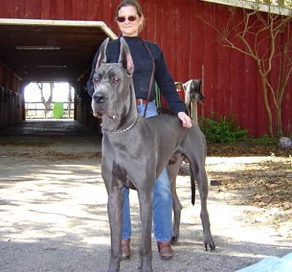
Great Dane
From http://louminatti.blogspot.com

Slide 47
The Doggie Planning Exercise
Labrador
1
2
3
?
Notes:
Images from Wikipedia: http://en.wikipedia.org/wiki/Chinese_number_gestures#Images

Slide 48
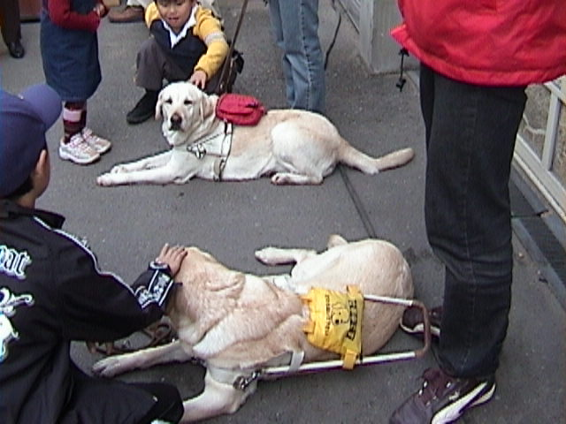
Labrador
http://en.wikipedia.org/wiki/Labrador_Retriever

Slide 49
The Doggie Planning Exercise
Poodle
1
2
3
?
Notes:
Images from Wikipedia: http://en.wikipedia.org/wiki/Chinese_number_gestures#Images

Slide 50
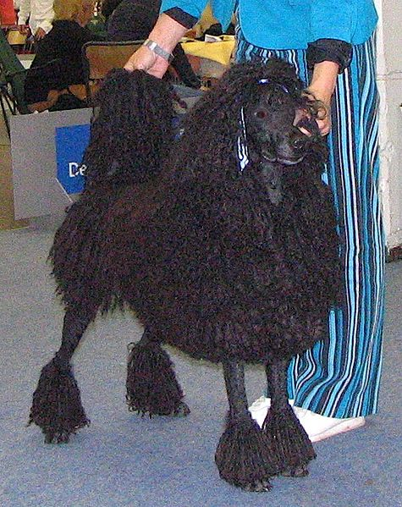

Poodle
Standard Poodle
Toy Poodle
http://en.wikipedia.org/wiki/Poodle

Slide 51
The Doggie Planning Exercise
Newfoundland
1
2
3
?
Notes:
Images from Wikipedia: http://en.wikipedia.org/wiki/Chinese_number_gestures#Images

Slide 52
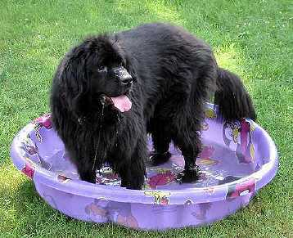
Newfoundland
They are famously known for their giant size and tremendous strength, sweet dispositions, and loyalty.
hhttp://www.knowledgerush.com/kr/encyclopedia/Newfoundland_%28dog%29/

Slide 53
The Doggie Planning Exercise
Austrian Guildenbaur
1
2
3
?
Notes:
Images from Wikipedia: http://en.wikipedia.org/wiki/Chinese_number_gestures#Images

Slide 54
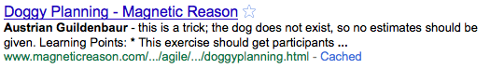
Austrian Guildenbaur
“this is a trick; the dog does not exist”

Slide 55
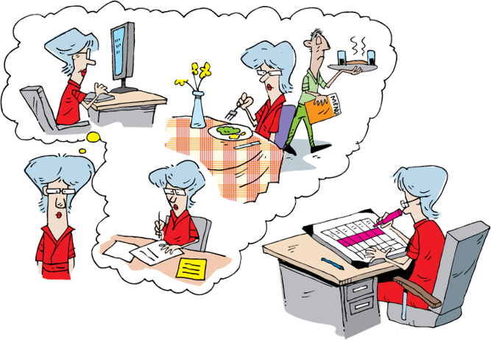
Time-Based Estimation
Notes:
Developers are asked to estimate the time to complete a story.
How do we consider other activities
Email
meals
Meetings
breaks
We use a concept called …..[Next slide]
---------------------------------------------------------------------------------------------------------
Now that we’ve talked about Fibonacci numbers and planning poker, let’s consider some other methods of estimating.
When doing time-based estimating, we are usually asked to provide the calendar time that it will take to complete the story. [CLICK] Each of us has to consider what other activities might occur during that time – whether it’s dealing with email, stopping for meals, or participating in meetings, [CLICK] or whether we take breaks to play computer games or live sports. Whatever it is that fills our time, we have to include not only the time spent on task, but also the time spent on other things. After all, we know that we don’t spend all of our time focused on the task at hand.
The problem with this is that when we’re putting together a classic project plan, we can’t factor in people’s work habits.
In order to address this, some folks doing Agile estimate using [NEXT SLIDE]

Slide 56
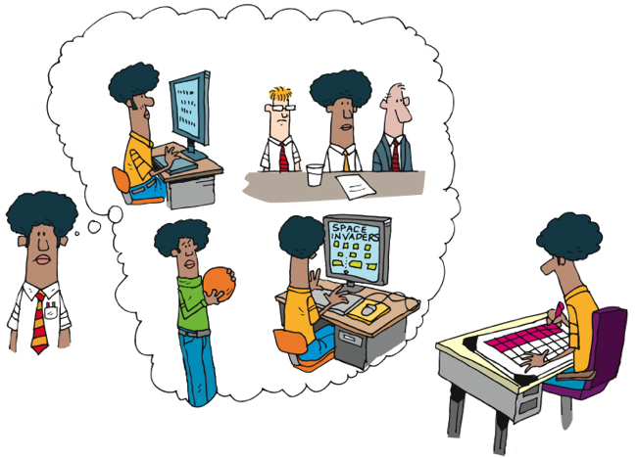
Time-Based Estimation
Notes:
Developers are asked to estimate the time to complete a story.
How do we consider other activities
Email
meals
Meetings
breaks
We use a concept called …..[Next slide]
---------------------------------------------------------------------------------------------------------
Now that we’ve talked about Fibonacci numbers and planning poker, let’s consider some other methods of estimating.
When doing time-based estimating, we are usually asked to provide the calendar time that it will take to complete the story. [CLICK] Each of us has to consider what other activities might occur during that time – whether it’s dealing with email, stopping for meals, or participating in meetings, [CLICK] or whether we take breaks to play computer games or live sports. Whatever it is that fills our time, we have to include not only the time spent on task, but also the time spent on other things. After all, we know that we don’t spend all of our time focused on the task at hand.
The problem with this is that when we’re putting together a classic project plan, we can’t factor in people’s work habits.
In order to address this, some folks doing Agile estimate using [NEXT SLIDE]

Slide 57
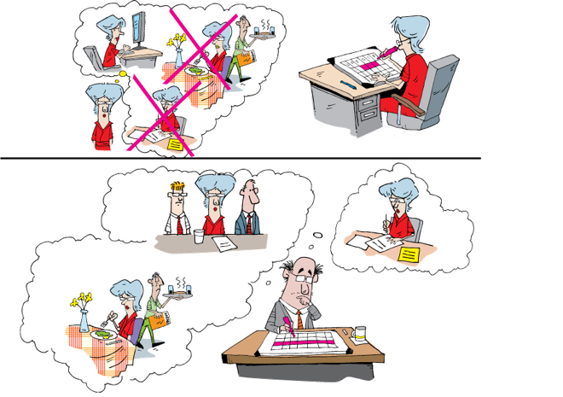
Ideal Time
Notes:
Ideal time
Time actually spent on completing the task
Includes testing and refactoring
Eliminates the interrupts and so forth
Assumes the average pair on the team
No factors for speed or expertise
------------------------------------------------------------------------------------------------------
…what is referred to as Ideal Time. Ideal Time can be defined as the time actually spent on task with a constant overhead factor applied.
That is, let’s say that I think a task will take me twelve hours to complete. That’s not really one-and-a-half days, because I do have to attend meetings and deal with interrupts and so forth. My project manager, in calculating the actual effort, will apply a multiplier – let’s say 100% - and therefore schedule twenty-four hours for this task.
The value of Ideal Time is that it allows the people doing the estimating to answer the question “In the ideal scenario, in which I do nothing but work on this task, how long would it take?” It takes out the interrupts and distractions on an individual basis, and adds them as a constant multiplier that applies to all.
This still doesn’t deal with variations on speed and expertise, unfortunately. That’s why we prefer to use relative units like Fibonacci numbers.

Slide 58
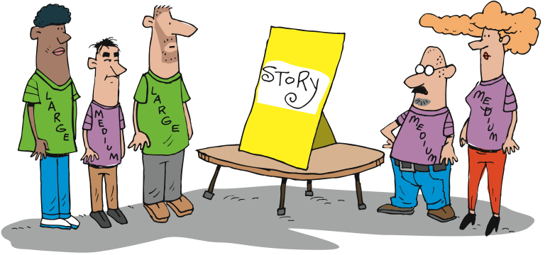
Granularity of Estimation
Notes:
T-shirt sizing is sometimes used as a starting point
Will need to be translated to time at some point
Helpful when thinking about a new module or initially sizing a project
----------------------------------------------------------------------
Another simple method of relative estimation is T-shirt sizing. The simplest is to estimate each story as small, medium, or large. You can include extra small, extra large, and extra extra large if you like. Any system that estimates stories relative to other stories will work.

Slide 59

Velocity
Notes:
Now we need to figure out how fast we think we can work
Initially it’s a guess. Experience makes our guesses more accurate and precise.
Velocity – the amount of work that we can complete in an iteration
-----------------------------------------------------------------------------------------------------------
Once we’ve figured out how difficult each of our stories is, then we need to figure out how many we can fit into an Iteration. That’s what we call velocity – the amount of work, computed based on our estimates, that will fit in an Iteration.

Slide 60
story11
story6
story1
story12
story7
story2
story13
story8
story3
Est: 1
Story14
story9
story4
story15
story10
story5
Notes:
Lay all cards out
Find the easiest one [CLICK]
We give that a 1 [CLICK]
We compare the rest of the stories relative to the first (easiest one)
----------------------------------------------------------------------------------------------------------
Of course, at the beginning, we don’t know what our estimates or velocity are. So let’s look at how we get started.
We’ll begin by figuring out how to estimate – after all, we haven’t estimated any of these stories yet, as a team. So we begin by laying out all of our stories on the table. We look them all over, one by one, and try to find the story we all think is as easy as any other story. [CLICK]
Assuming that we’re using Fibonacci numbers, we’ll assign this story a one [CLICK], which is the lowest estimate. You might remember that we included zero in our set of numbers – that’s reserved for the case when we say “Oh – we got this work done when we were doing something else – there’s no effort here.”
So, now we’ve got a story that’s a one. We begin the process of comparing all of our other stories to this one. Is each story more difficult than this one? How about these other ones?
[NEXT SLIDE]

Slide 61
story11
story6
story1
story12
story7
story2
story13
story8
story3
Story14
story9
story4
story15
story10
story5
Notes:
Proceed by sizing the rest of the stories in relation to the 1st one and to each other
Now what do we do with them?
---------------------------------------------------------------------------------
As we proceed, we estimate each story based on how hard it is in relation to our baseline story.
When we’re done, each story has been estimated, all of them relative to each other.
This allows us to move on to the next activity…

Slide 62
5
3
8
1
2
2
2
3
3
5
1
8
Notes:
We take our estimated stories [CLICK]
…something we call the Raw Velocity Game.
In the Raw Velocity Game, the goal is to estimate our initial “raw” velocity, so that we can know how many stories to choose for our first Iterations.
We start with all of our stories [CLICK] and their estimates. Then we cover all the estimates [CLICK].

Slide 63
5
3
8
1
2
2
2
3
3
5
1
8
Notes:
We cover up the estimates
We take a random sample of cards and lay them out
We ask the developers which cards they feel could be done in 1 iteration
We calculate the total
We repeat
We average
The team now examines all the stories and chooses a set to answer the question “Pick a set of stories that you think you can get done in one iteration.” The idea is to pick just enough stories to fill an iteration, without overfilling it.
Once the team has picked some stories… [CLICK] pause [NEXT SLIDE]

Slide 64
3
5
8
1
2
2
2
3
Round one: 8
3
5
Round two: 11
Round three: 9
1
8
Average: 9
Notes:
We calculate the total
We repeat
We average
Gives us a starting point
Adjusted throughout the project
Assume lower velocity at the beginning of a project
Team needs to jel
Things the impact velocity
Technology
Delivery model
Team size
Full time/part time devs
----------------------------------------------------------------------------------------------------------
… we reveal the estimates [CLICK] and total them up. [CLICK]
We then repeat this process two more times, getting the team’s best guesses [CLICK], and we average all three rounds [CLICK].
The resulting number – nine in this example – gives us our initial, raw velocity. [CLICK] We’ll use this number to determine how much work we think we can get done in our first few iterations.

Slide 65

Spikes
Solve hard technical problems through real experiments… without tampering with production code
Notes:
Time boxed
Throw away
Done during inception, but typically environments are set up yet
Done during Iteration 0, but initial estimate has already been given

Slide 66
In Summary
Accuracy and Precision
Estimating Systems – Fibonacci Sequence
Planning Poker
Ideal Time
Calculating Raw Velocity
Spikes

Slide 67
Release Planning
Notes:
We have stories
We have estimated the stories
We know about how much work we can get done in an iteration
We know about how many iterations we have
Now we need to put the stories into Releases
Now that we’ve talked about stories and roles and personas and low-fi prototyping and storyboarding – that is, the tools and artifacts that enable us to know what we’ll be building - let’s talk about how we do our planning and communicating.

Slide 68
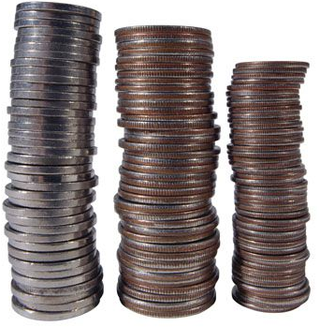
Deciding on Releases
Notes:
Release planning is really prioritizing the stories into workable releases
Release and iteration
Usable by the biz vs working software
------------------------------------------------------------------------------------------------------------
We’re getting there…
We’ve talked about user stories and the tools we use. We’ve estimated and
Now let’s move on to how we figure out how much we can get done, and then how we go about choosing our stories to implement.

Slide 69
All the Pieces
We have:
Stories
Estimates for each story
Estimated velocity
But where do we start?

Slide 70
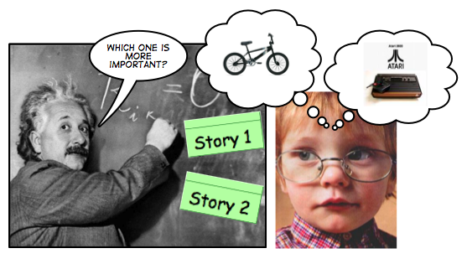
Relative Priority
All the decisions about item priority have to involve other items which are being traded in favor of the most important one(s). There is no absolute priority, only relative to other items.
http://fabiopereira.me/blog/2009/06/29/principle-of-relative-priority/
Notes:
There are many techniques used to prioritize the stories
Use the quantifiable Business Objectives
The Principle of Relative priority
According to Fabio Pereira: All the decisions about item priority have to involve other items which are being traded in favor of the most important one(s). There is no absolute priority, only relative to other items.
Prioritize difficult technical issues
Prioritize complex analysis items
Games you can play – Luke Hohman
Buy a feature
MoSCOW
Must have, should have, could have, won’t have
Desirablity, Risk, Impact, Cohesion
----------------------------------------------------------------------------------
Once we’ve decided how to organize our work, we then have to decide which things to do when. One way to approach this is The Principle of Relative Priority:
According to Fabio Pereira: All the decisions about item priority have to involve other items which are being traded in favor of the most important one(s). There is no absolute priority, only relative to other items.
This means that – just like estimating stories, which we’re going to get to shortly – our goal is to understand our choices, and then rank order them such that every story is more or less important than every other story. Along the way, we must also understand that these priorities can – and likely should – change during the life of the project, due to changes in the business environment.

Slide 71
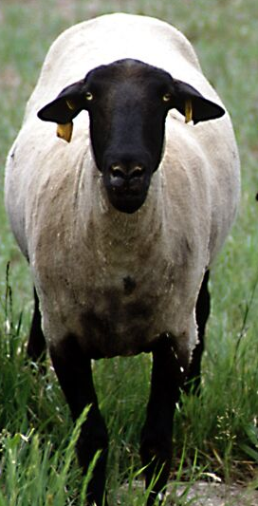
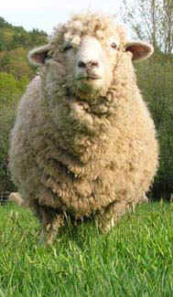
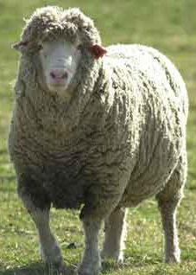
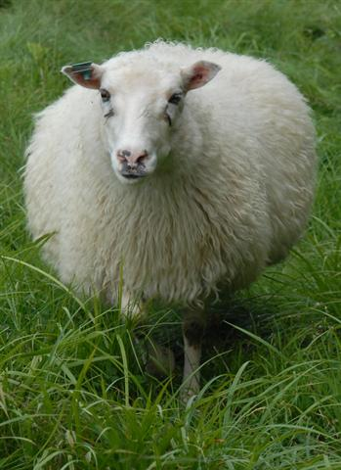
Sheep Judging
Notes:
Relative importance – “sheep judging”
When judging sheep (or any other animal) at the State Fair, a pretty simple approach is used. The judge decides which is the best sheep (at this stage), and moves that sheep to the center. (click)
Now the rest of the sheep are judged according to this standard – is the next sheep better or worse than the “standard sheep” (click)
Is the next sheep better or worse than the standard? (click) Better or worse than the one below standard? (click)
We can do the same thing with stories – which is the most important, which next, and next, and so forth. This forces you away from “everything is critical”…

Slide 72
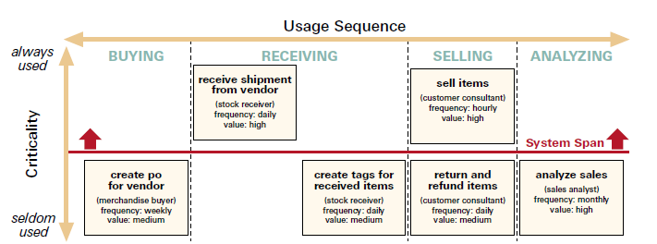
Span Planning
http://www.agileproductdesign.com/writing/how_you_slice_it.pdf
Notes:
Jeff Patton
Lay out the stories horizontally in process sequence
Place them by vertically by criticality
Small example
300 – 400 stories there is a pre-grouping first
Need lots of space

Slide 73
Vertical Slice
Value
Value
Value
Presentation Layer
Function/Feature
Function/Feature
Function/Feature
Presentation Services
Business Services
Data Store
Notes:
All releases must be vertically sliced
Meaning it has to work from the UI to the Data store
Concept of ‘minimally marketable features’. Remember the kitchen and bathroom complete before the rest of the house.
Determine which Features collectively apply.
----------------------------------------------------------------------------------------------------------
There are a few ways to view the system, and decide on how to organize the work. We’re going to talk about two of them here: Vertical Slices and Story Mapping.
In Vertical Slicing, we consider a part of the system that delivers value all by itself. Or as much by itself as possible. That is, [NEXT SLIDE]

Slide 74
The Release Plan
Release 1
Release 2

Slide 75
The Release Plan
Release 1
Release 2
Notes:
Now we can put the most important / highest value stories into the release plan first, followed by the second priority, third priority, and so on.
You might even make an initial plan for the first couple of iterations (scrums), but be careful not to put too much effort into planning every iteration (scrum) throughout the entire release – remember that changes happen, and we need to be flexible enough to embrace these changes.

Slide 76
In Summary
Prioritizing stories
Minimally Marketable Features
Span Planning
Release plan

Slide 77
Review: Module Objectives
Learn the purpose and attributes of stories
Understand the relationship of stories, acceptance criteria and testing
Learn about roles and personas and scenarios
Learn how to estimate agile stories
Learn how to plan using estimates, spikes and velocity
Understand the agile lifecycle and planning cadence
Learn about agile metrics and communication
Notes:
Inputs
Capacity
Story Lifecycle
Outputs

Slide 78
Questions?

